Slide 1
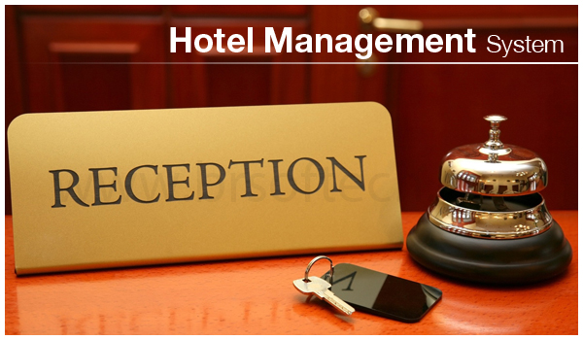
Saurabh Dhaigude Chase Jensen Shravani vadde

Slide 2
Introduction
The project Hotel Management system is an application that allows the Hotel manager to handle all the hotel activities. Hotel management project provides room booking, staff management and other necessary features.

Slide 3
Strategy to the project
1) Requirements of project 2) Creating the database 3) Creating the user interface 4) Implementing the backend logic 5) Test and debug 6) Deploying and maintaining

Slide 4
Tools:-
Backend:– Python and SQLITE Software:- PYCHARM

Slide 5
Ethics & critical thinking in our project
1) Identifying potential ethical issues 2) Evaluating the impact 3) Designing with ethics in mind 4) Monitoring and evaluating 5) Reflect and improve

Slide 6
Thank you

